Slide 1

Why dung beetles
are a good idea
Dr Shaun A. Forgie

Slide 2

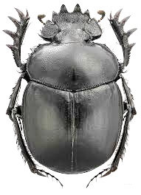
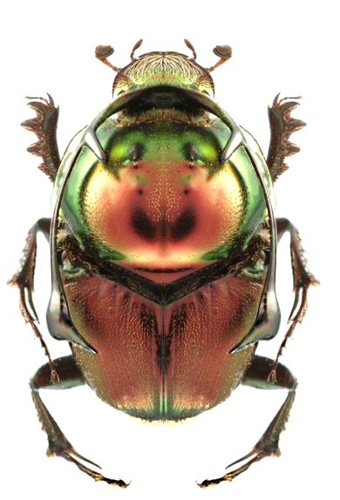
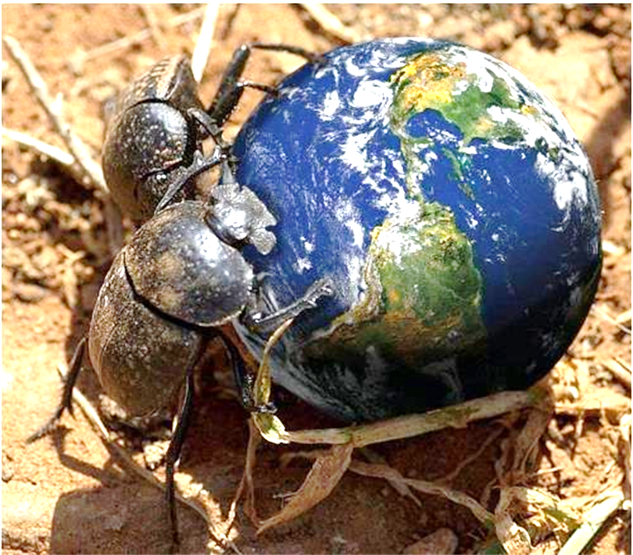
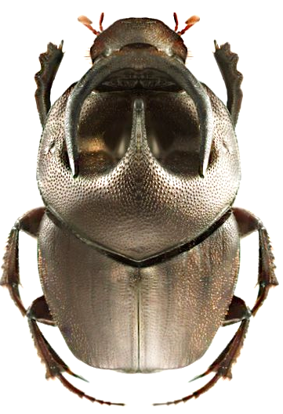
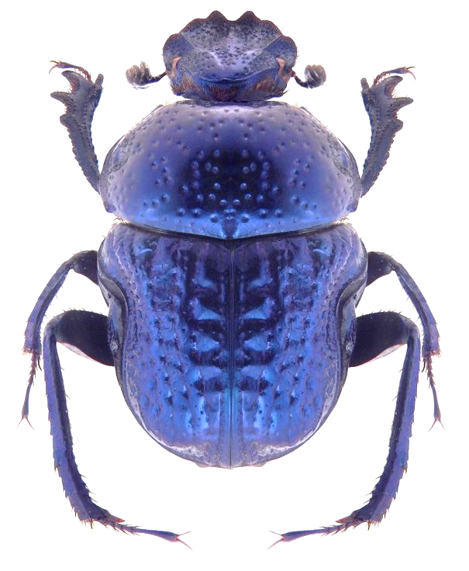
7,000 species around the world ……. except antarctica!
That’s more than all known species of mammals (c. 4,500)

Slide 3
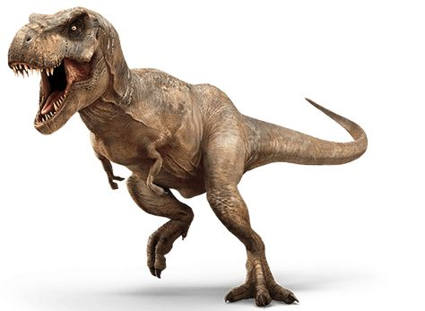
Fossil evidence indicates the earliest dung beetles date back to at least the Lower Cretaceous (ca. 98-144 mya).

Slide 4
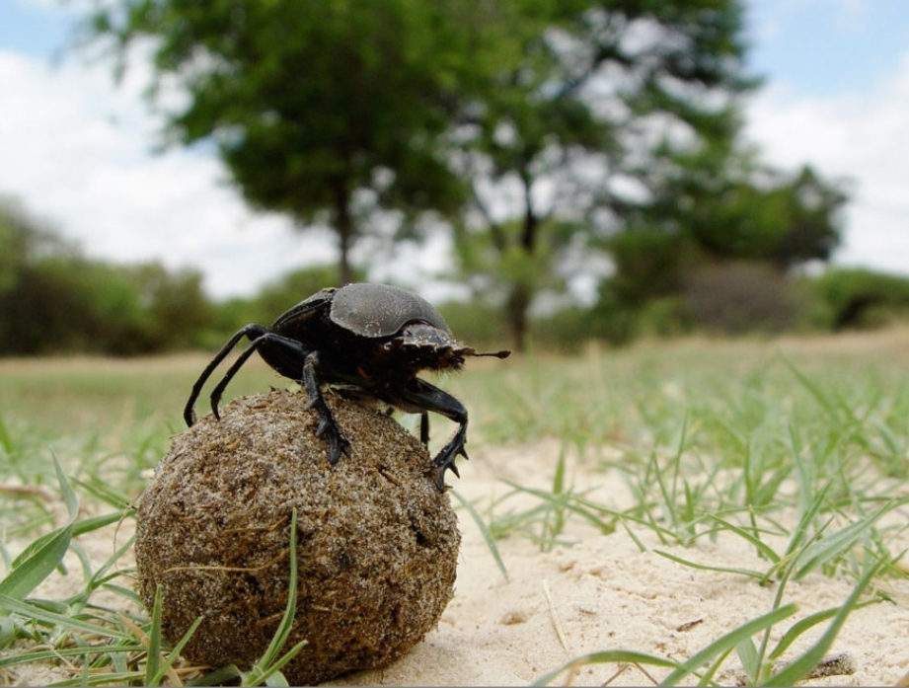
Dung beetles are among most well studied groups of insects in the world because of their behaviour and the ecological services they provide

Slide 5
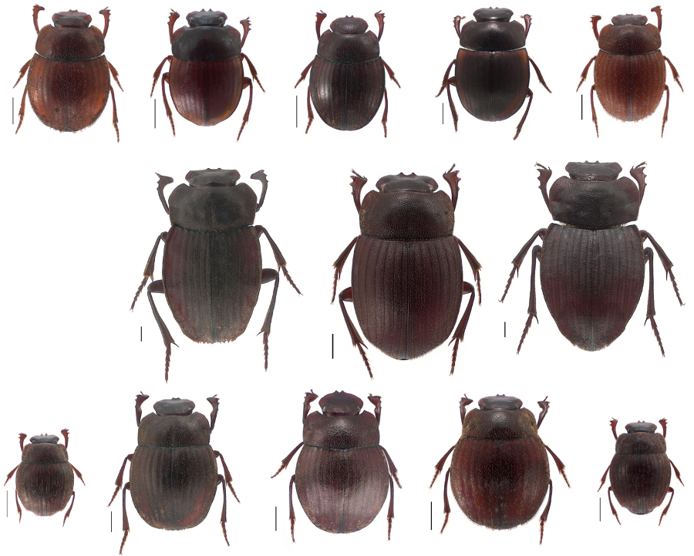
Native
Dung Beetles
Scale bar
= 1mm

Slide 6
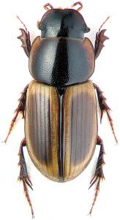
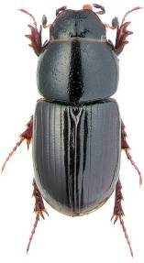
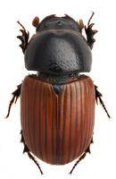
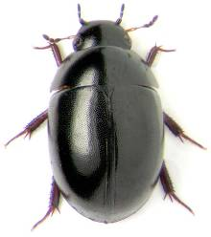
Exotic pastoral dung beetles already in NZ

Slide 7
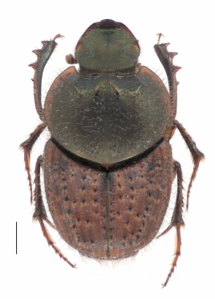
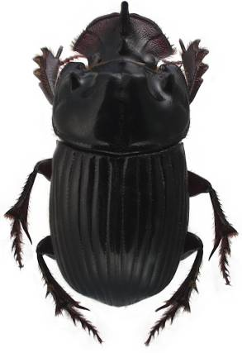
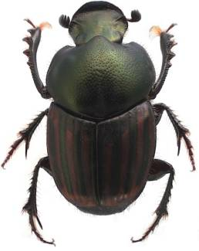
Exotic pastoral dung beetles already in NZ

Slide 8
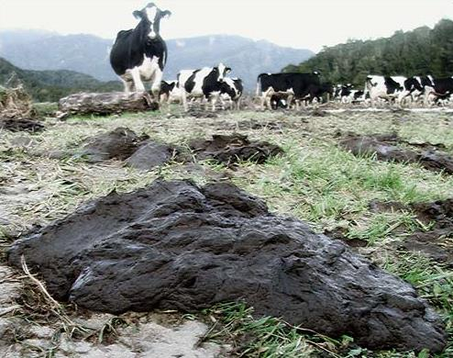
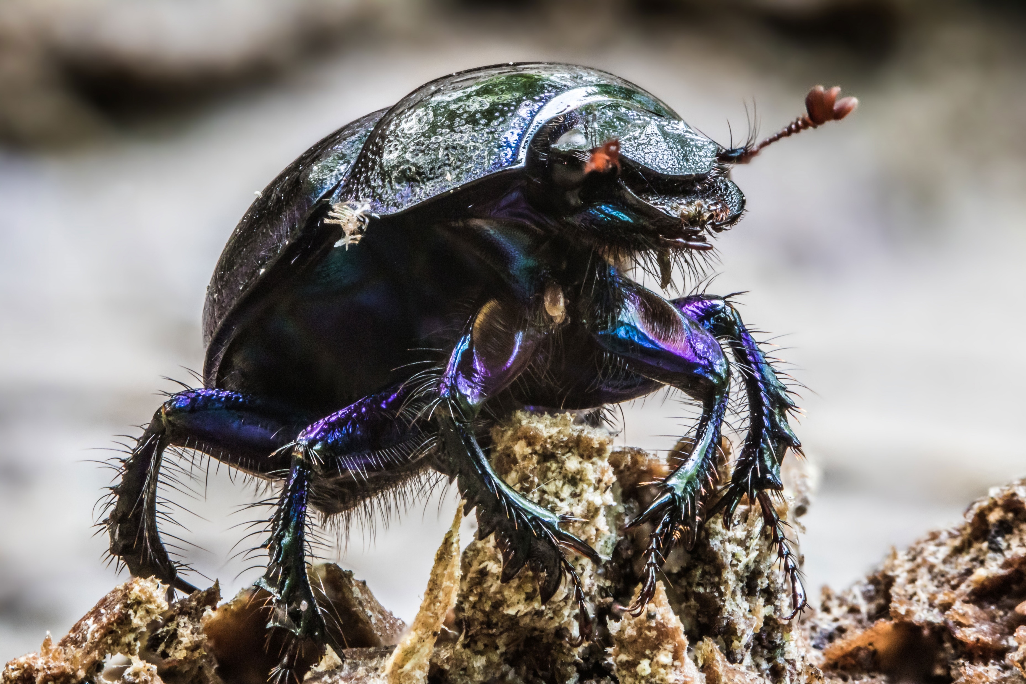
Why do we need exotic
dung beetles in New Zealand’s livestock pastures?
An absence of pastoral dung beetles resulted in ……….
Excessive accumulation of manure on the pasture
Soil compaction

Slide 9
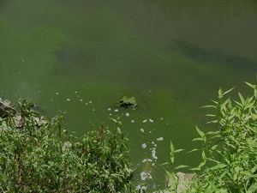
Which leads to ….……….
Reduced pasture productivity
Surface runoff
Reduced water quality
Degradation in soil health
Loss of surface soils (erosion)
“A nation that destroys its soils destroys itself.”
- Franklin Rooseveldt

Slide 10
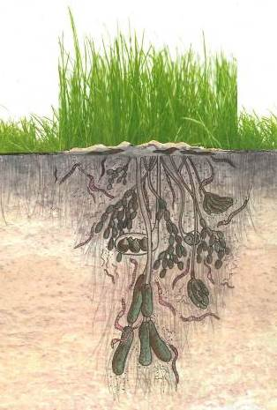
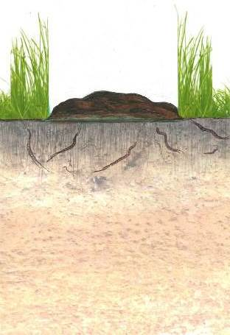
NO Dung Beetles
With Dung Beetles
10 cm
45-60 cm

Slide 11
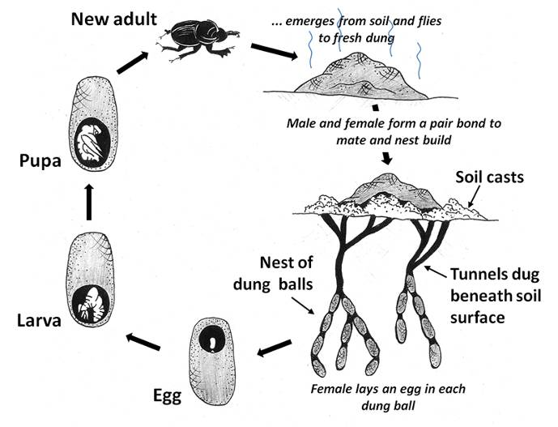
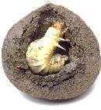
This becomes significantly important across a pastoral landscapes, and particularly those exposed
to repeated stock rotations
larva
45-60 cm

Slide 12
Why should you add
dung beetles
to the
pastoral landscape?

Slide 13

100 Million tonnes of manure is produced each year on NZ pastures!
That’s 100 Million tonnes of fertiliser and carbon if it is buried in the soil

Slide 14
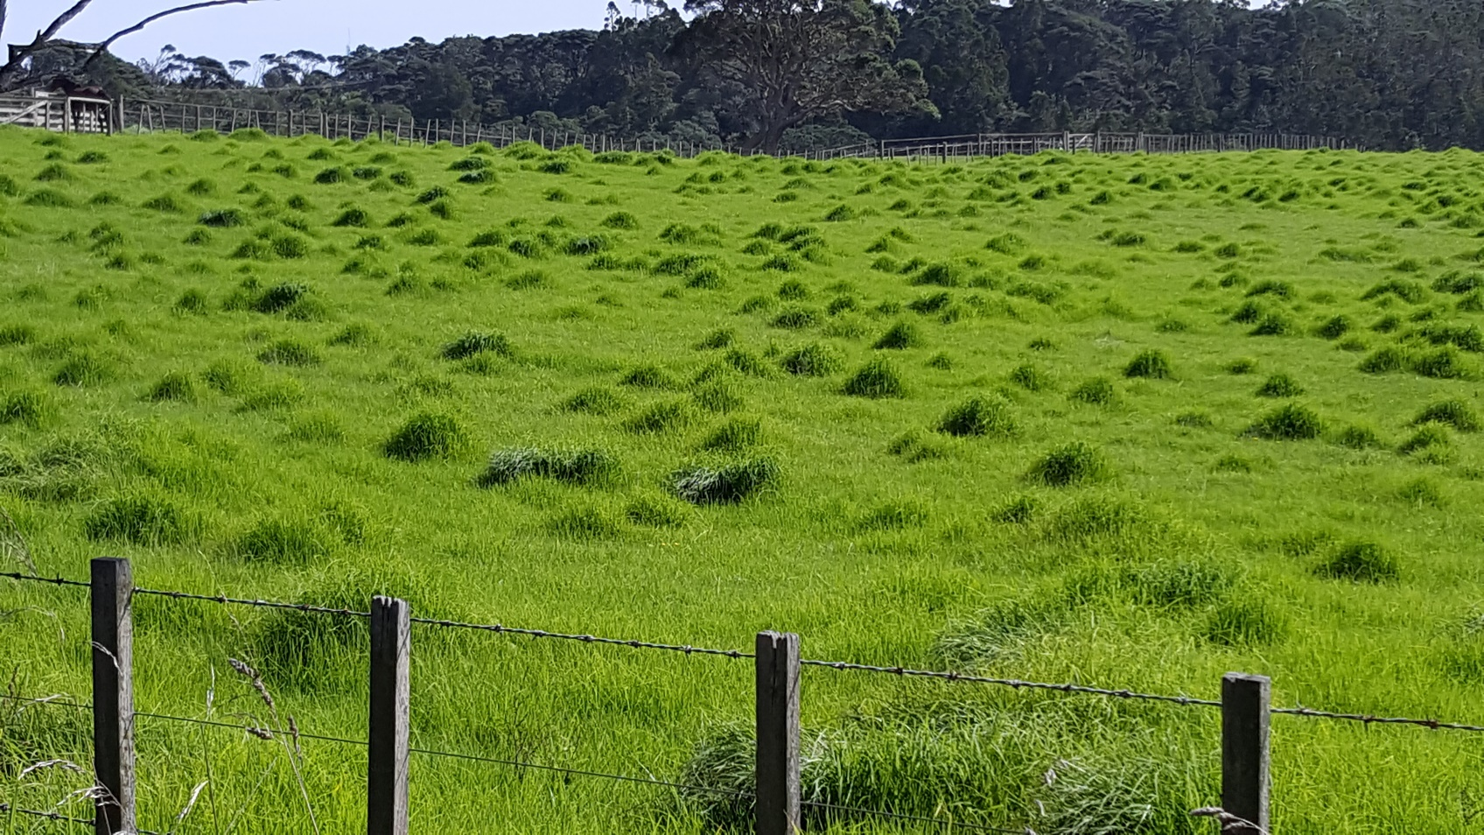
Forage fouling/avoidance
Rank growth
zone of repugnance: an area 5x the size of the dung itself
that is avoided by grazing animals.
Notes:
Pasture fouling by dung can significantly reduce the area available for grazing and with it reduced pasture availability and reduced productivity.
Calculations for dung coverage area were provided by Haynes and Williams ( 1993) for cattle and sheep.
IN combining both, we estimate up to 15% of all pasture in New Zealand is rendered unusable by at any one time from these livestock alone. Each dung patch occupies its original coverage area for at least one week!
CLICK: We know there is a zone of repugnance because of live stock avoidance of an area far greater than the dung itself.
Fincher 1981 calculates this to be an area 5x the size of the dung itself.
Hence the practice of break-feeding to force livestock to feed around their own excrement and thereby graze all the pasture. While unproven, such practices can only contribute negatively to livestock wellbeing and health ( esp. Increase diseases uptake and rates of parasitic infection).
The loss associated with cattle pasture fouling and resulting rank growth is substantial. It is estimated that five cows will decrease the effective area of pasture by one acre over one year (Bornemissza, 1960). For a herd of 100 cattle this equates to a loss of 20 acres per year. An American economic analysis estimated that pasture fouling causes an annual loss of 7.63 kg of beef per head of cattle and places the cost of reduced pasture fouling at $122 million per annum (Losey & Vaughan, 2006).

Slide 15


Pasture quality
Dung beetles can make a substantial contribution to ensuring that forage fouling is kept to a minimum
Several studies show “dung + beetles” results in significant increases in:
plant height
above ground biomass
grain production
protein levels
nitrogen content
plant height
above ground biomass
grain production
protein levels
nitrogen content
Root biomass and growing depth is significantly increased improving water holding capacity and drought tolerance

Slide 16
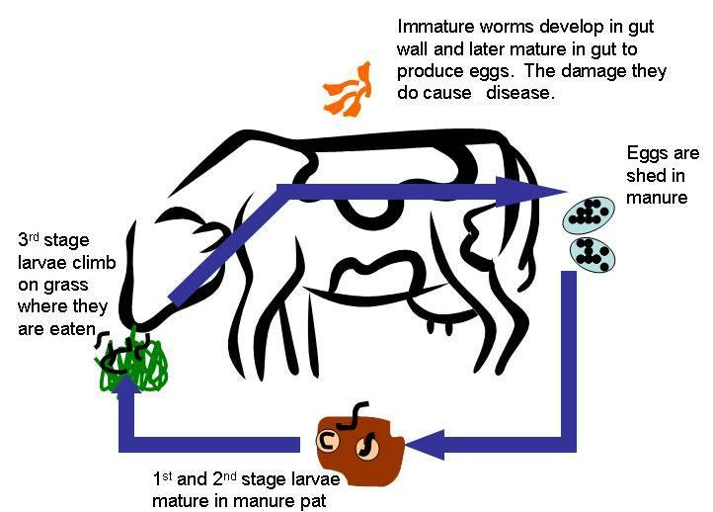
Reducing Pests

Slide 17
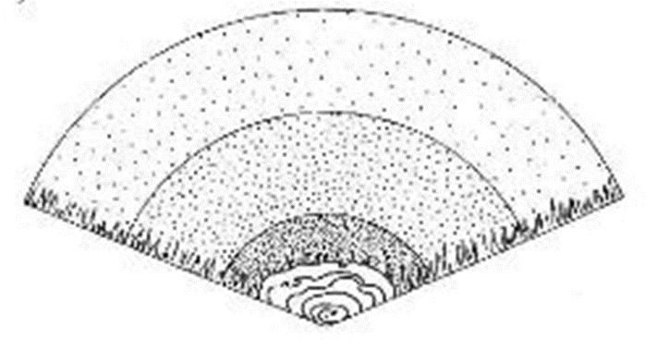
Reducing Pests
Notes:
Phoretic macrochelid mites carried between dung pads also predatory on fly eggs etc (Nichols et al 2008).

Slide 18
Reducing Pests
Many studies have shown significant reduction in numbers and/or reinfection rates of gut parasites
Miller et al. (1961)
Fincher (1973a, 1975)
Waterhouse (1974)
Bryan (1973, 1976)
Fincher & Stewart (1979)
Bergstrom (1983)
Gronvold et al. (1992)
Mathison & Ditrich (1999)
Le Jambre (2009)
Forgie et al. (2018)
Many studies have shown significant reduction in numbers of dung breeding pest flies
95% in Hawai’i (Bornemissza 1970)
88% in Australia (Ridsdill-Smith & Matthiessen, 1988)
Notes:
Phoretic macrochelid mites carried between dung pads also predatory on fly eggs etc (Nichols et al 2008).

Slide 19
Water Quality
Tunnelling and improvements to the physical structure of soils have a “flow-on” effect which include:
Improved water infiltration reducing surface ponding, assists agricultural inputs (lime, fertilisers) to enter the upper soil profile and reduce the level of contaminants entering the waterways…….. (Waterhouse 1974; Bormemissza 1976; Doube 2005b)
…which leads to improved water quality (Doube 2008)

Slide 20
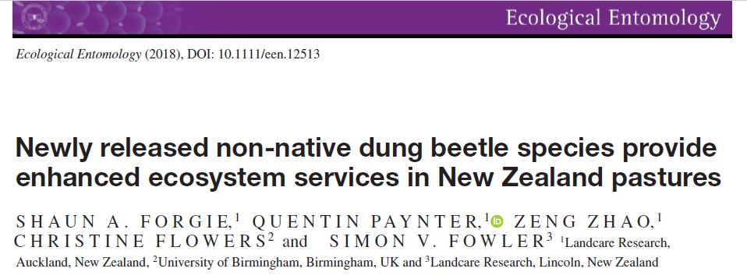
What's the impact of dung beetle activity on surface run-off and the amount of contaminants suspended in the run-off in severe rainfall events in New Zealand?

Slide 21
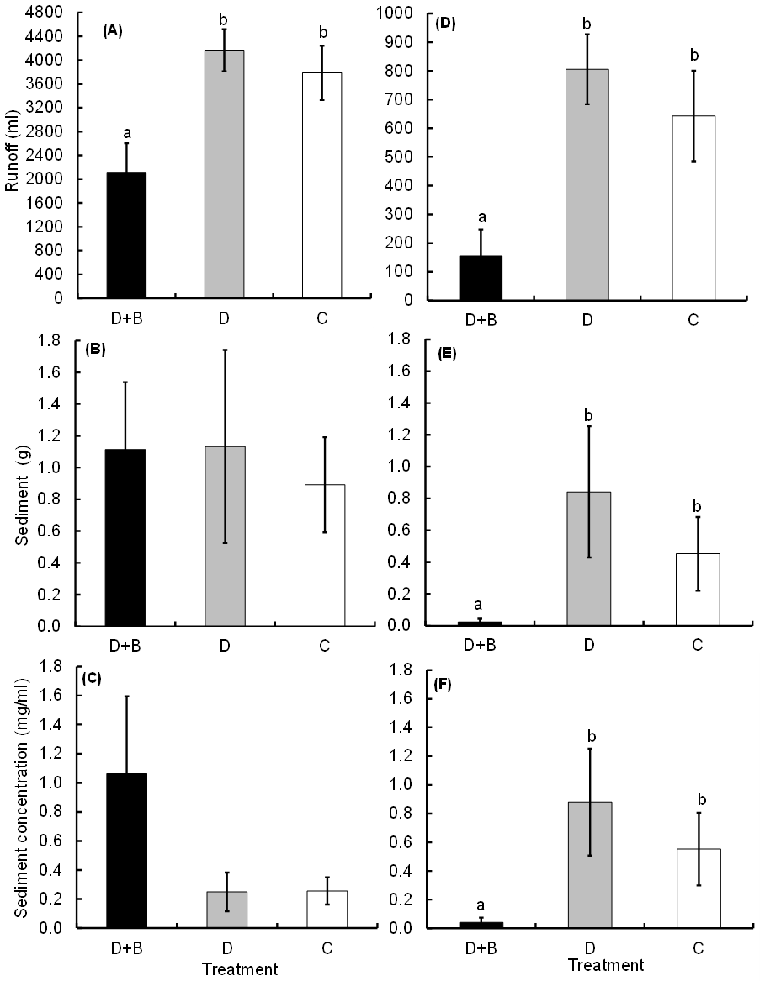
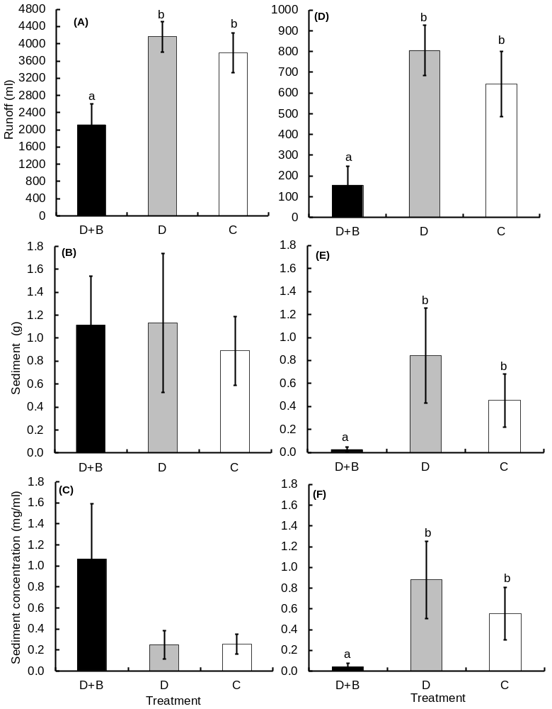
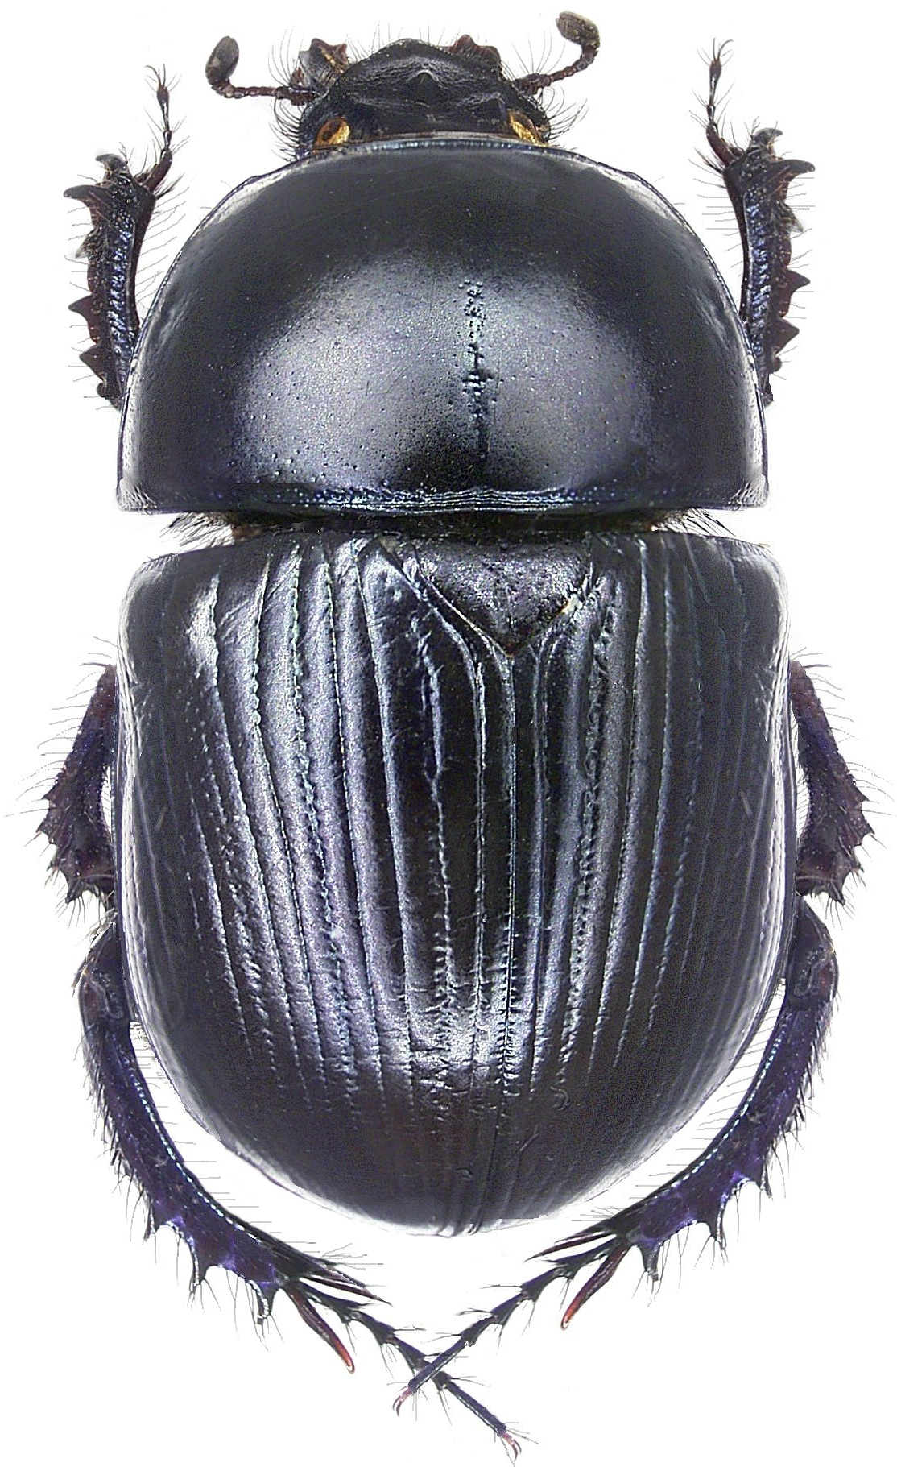
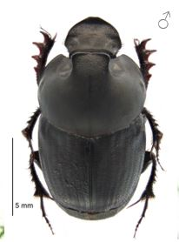
Results: High rainfall event
Mean run-off
Mean sediment in the run-off
Mean concentration of sediment in the run-off
81% less overland flow
91% less erosion

Slide 22
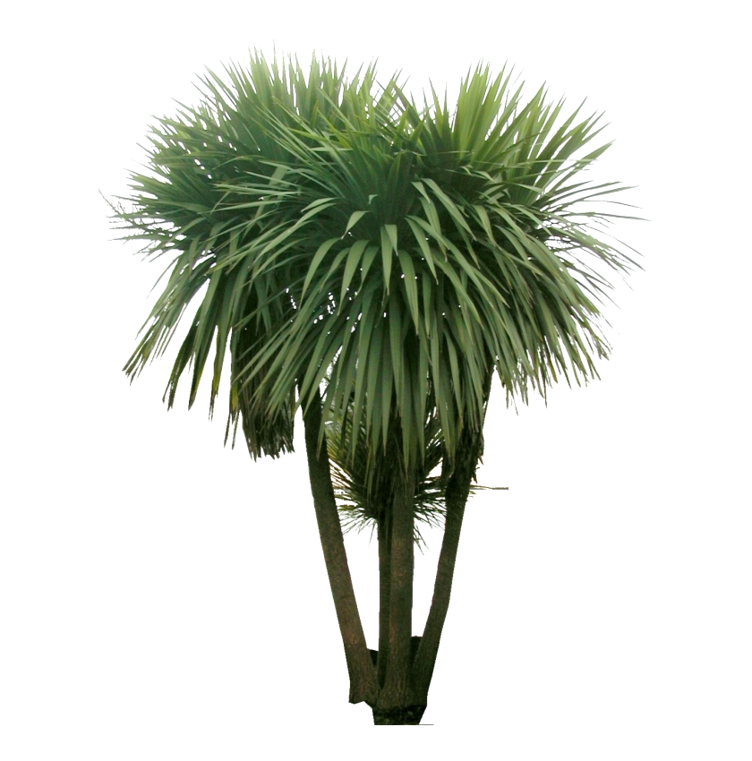
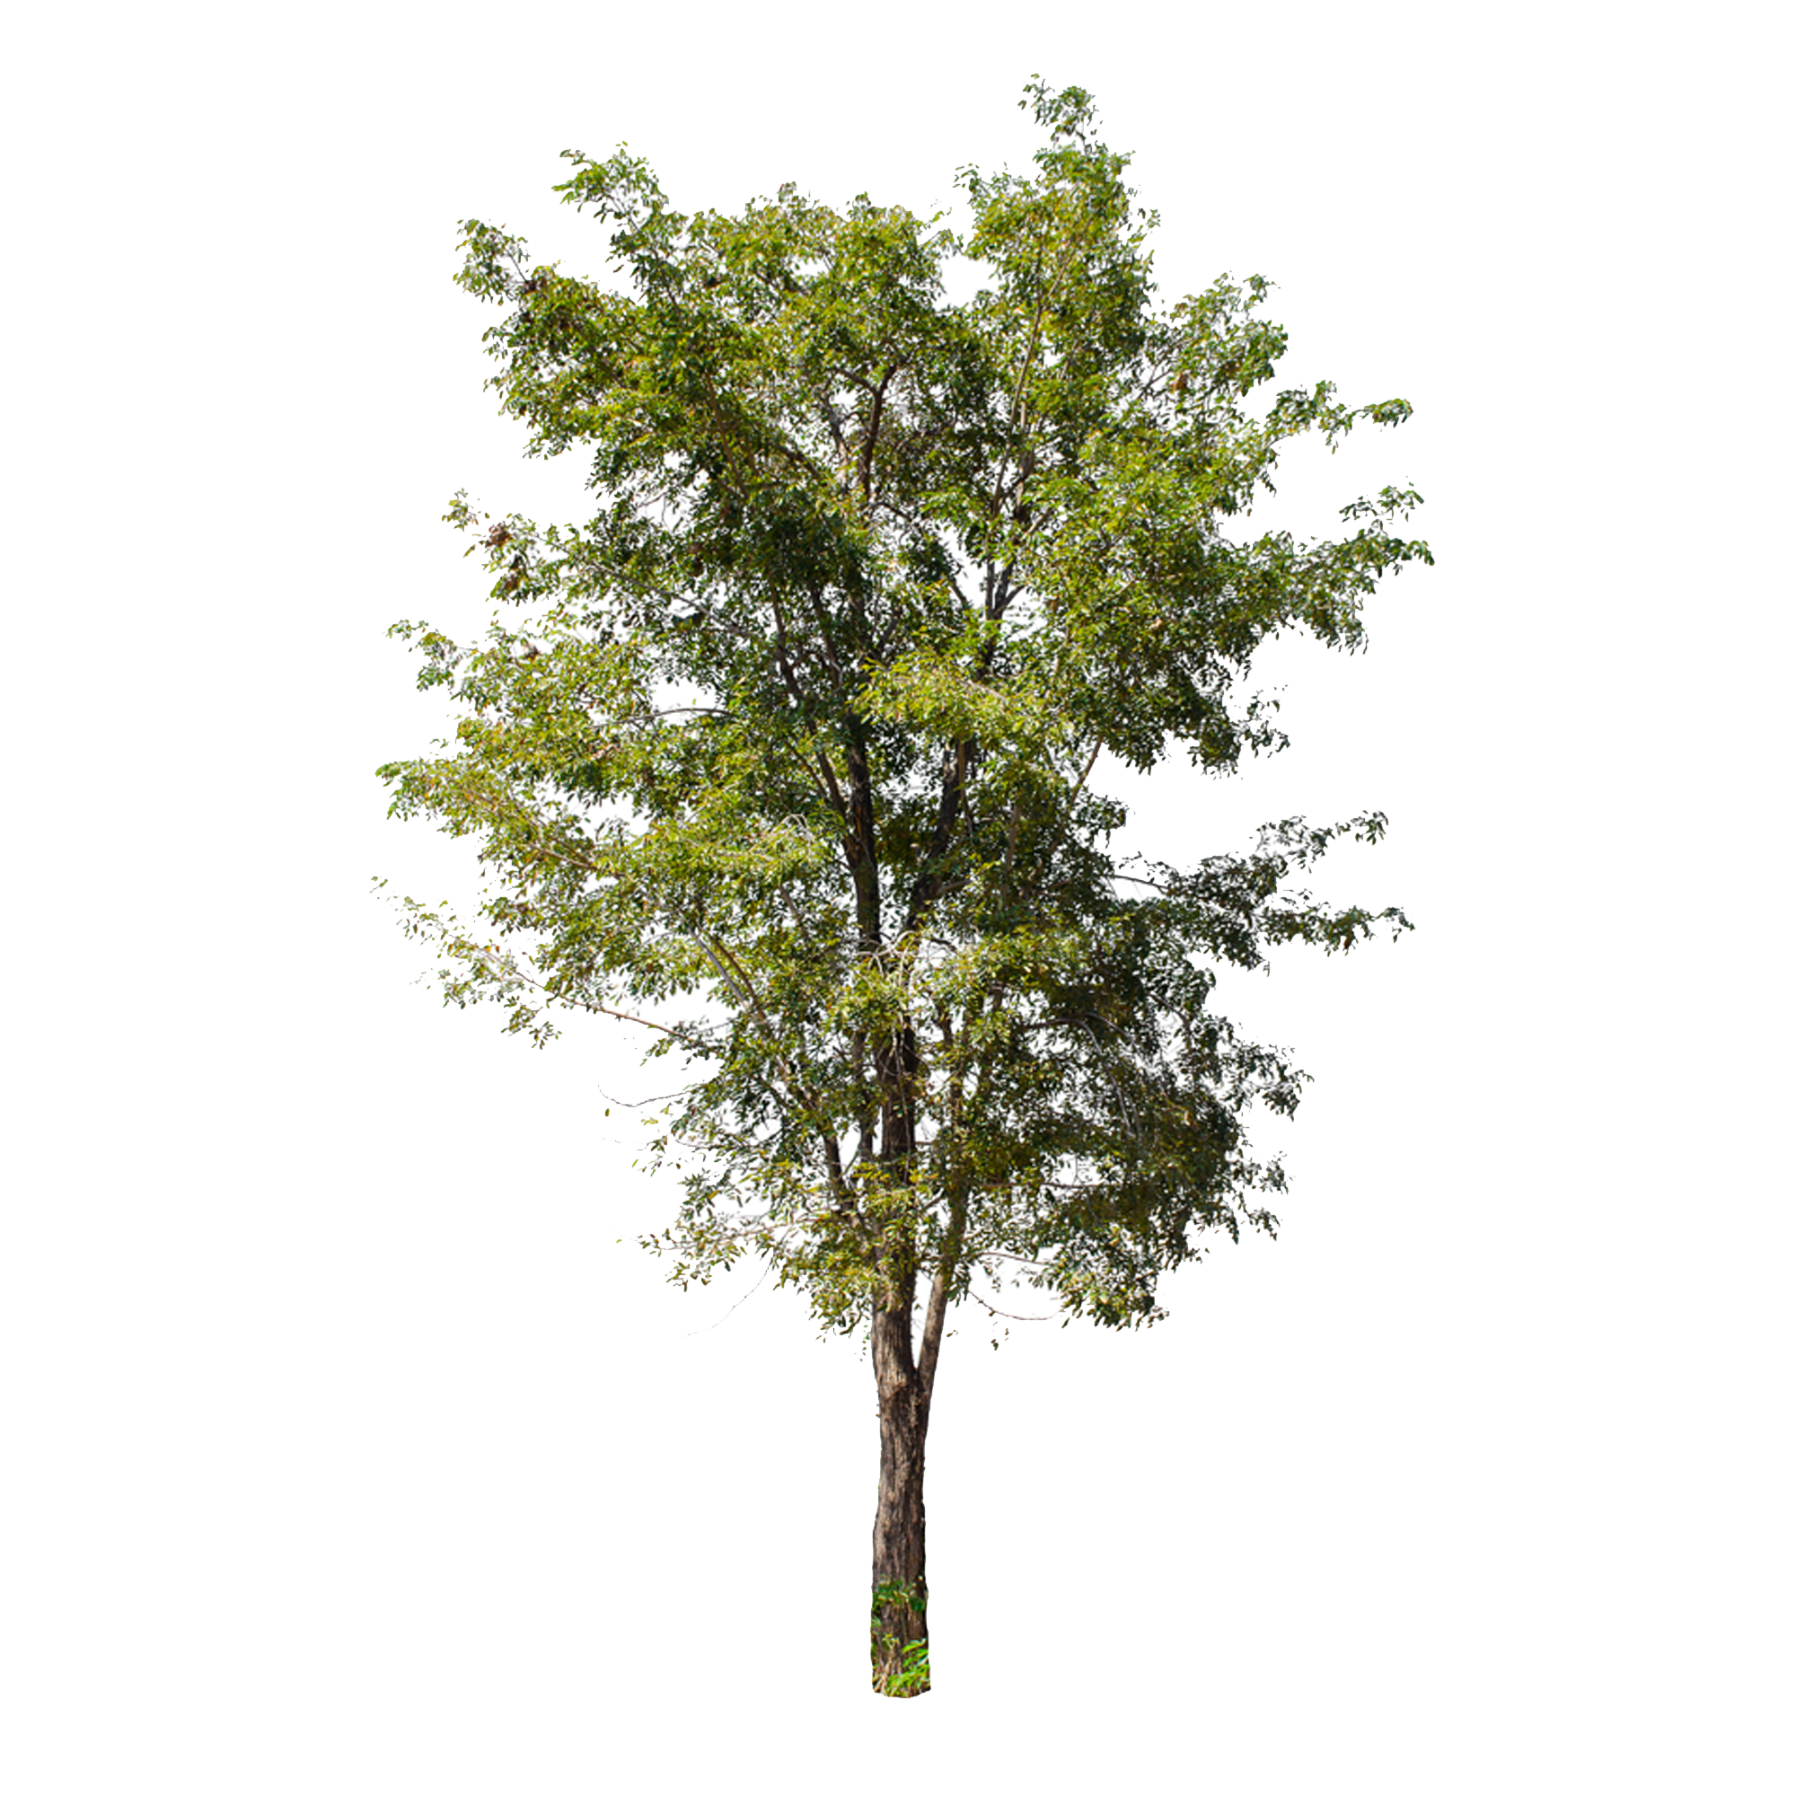
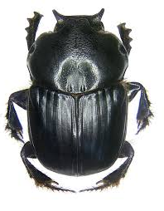
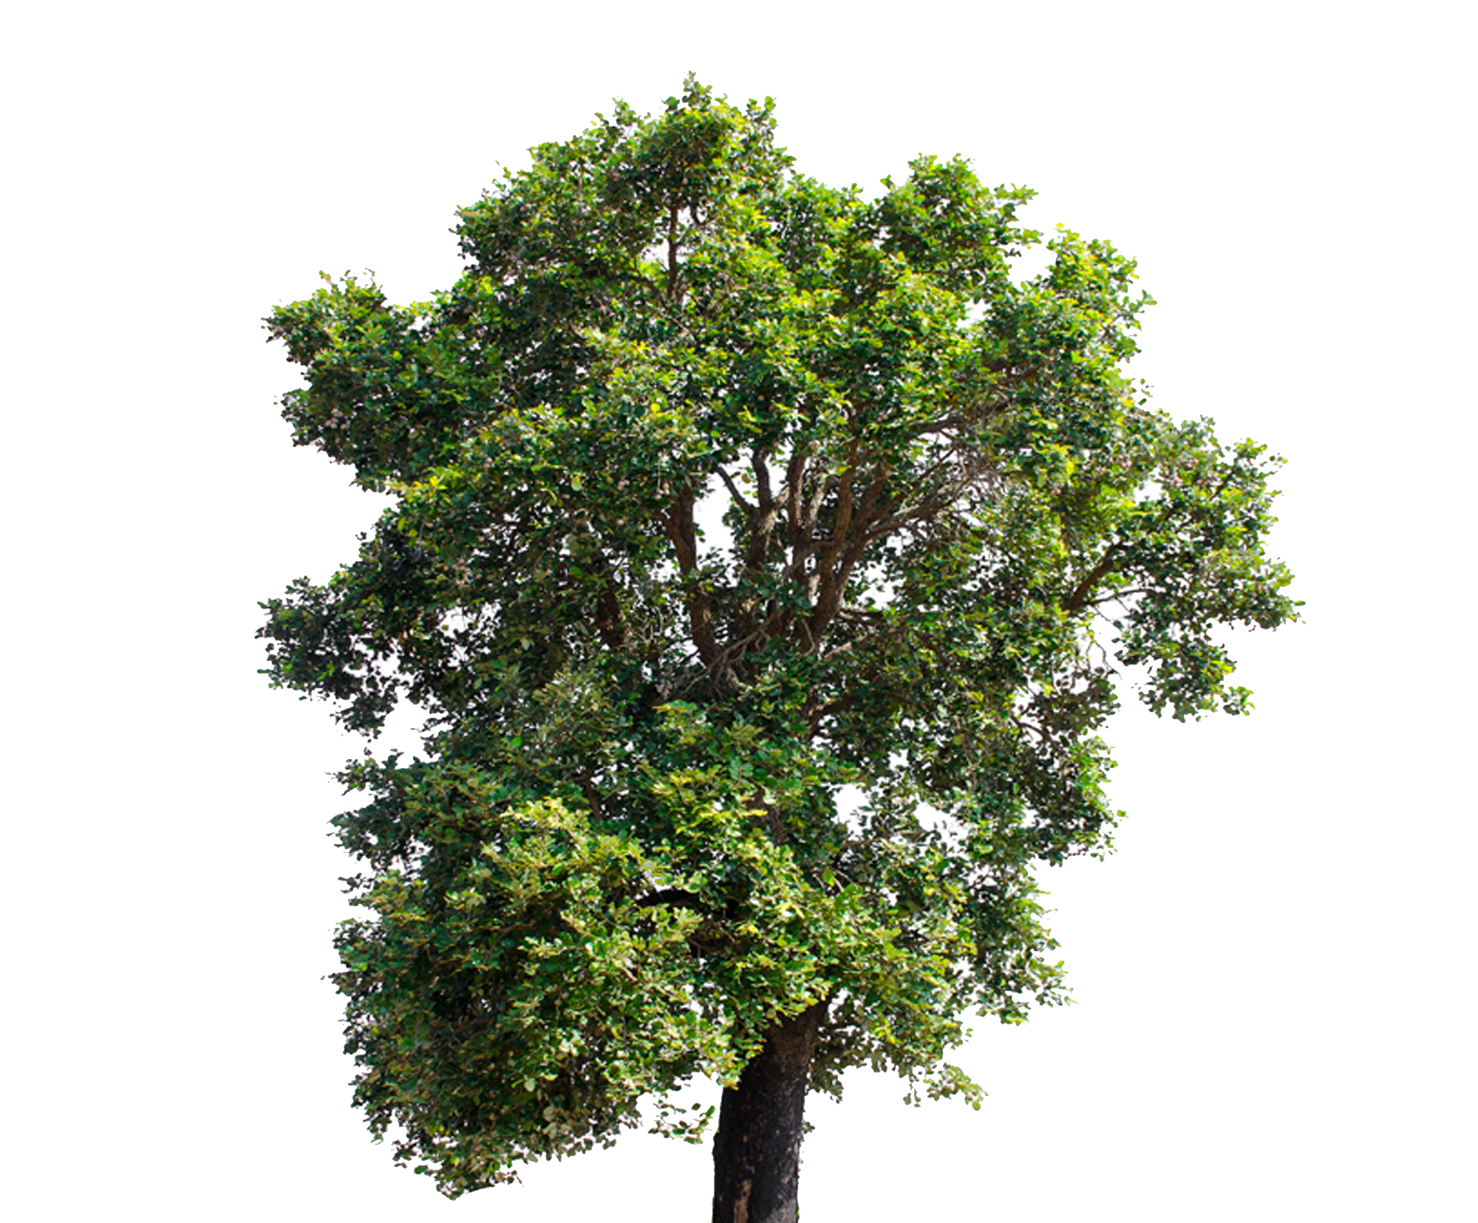
The best runoff solution is the most economical one by using dung beetles, planting, and fencing together in the key areas.

Slide 23
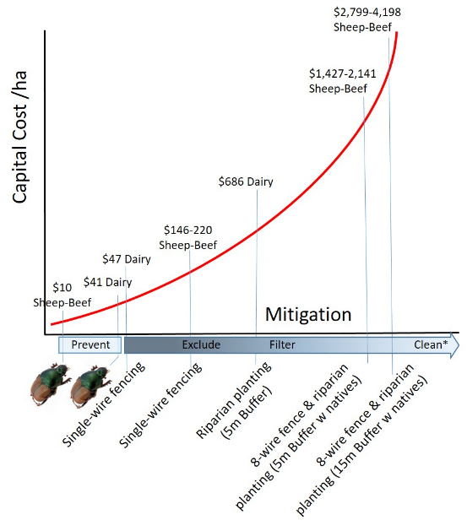
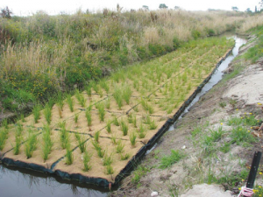
Dung Beetle figures based on Four Seasons Package ($6,600 + GST).
Source of fencing/riparian costs: http://www.waikatoriver.org.nz/wp-content/uploads/
* Clean: mitigation measures … wetlands, rafts (below), and lake-bottom dredging.
Graphic representation of cost ($) per hectare of existing and new mitigating measures for reductions in nutrient run-off from pastures.

Slide 24
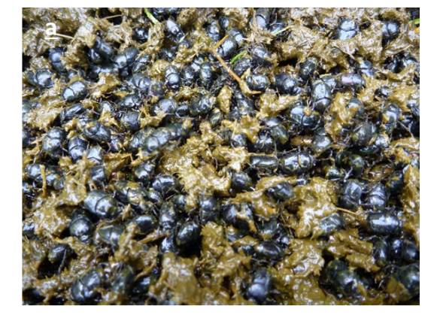
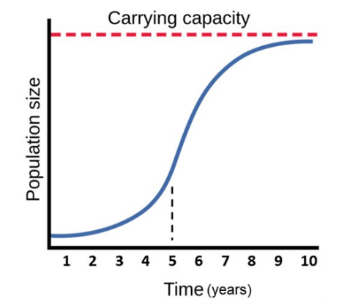
Managing Expectations
Dung beetle population growth rate is exponential post release, then changes to a logistic rate as it reaches and maintains a heavy carry capacity
The carry capacity is proportional to the amount of manure sustainably produced on a farm.

Slide 25
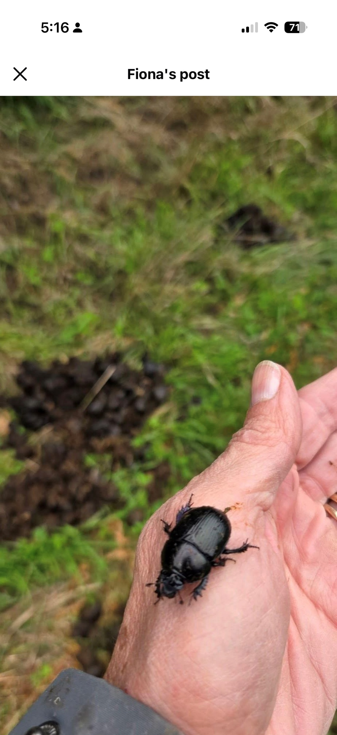
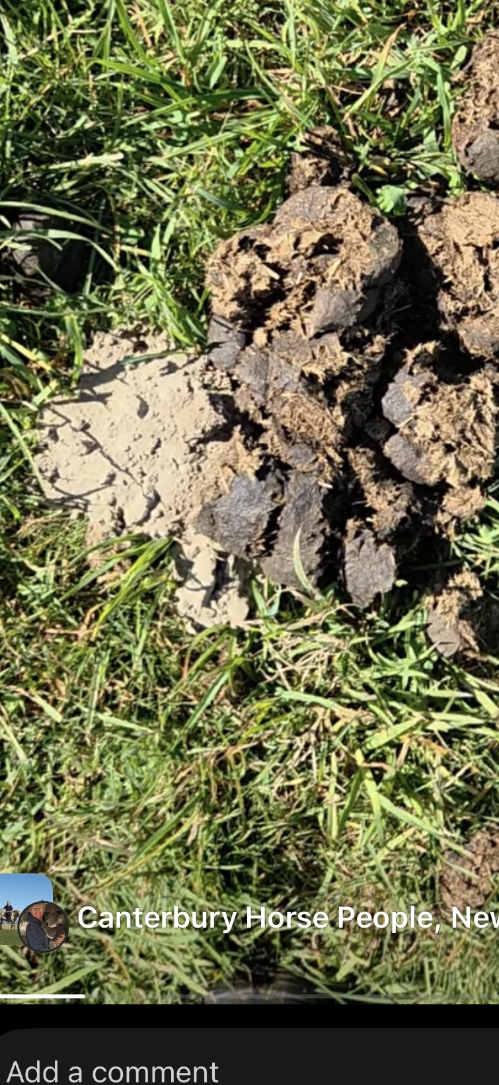
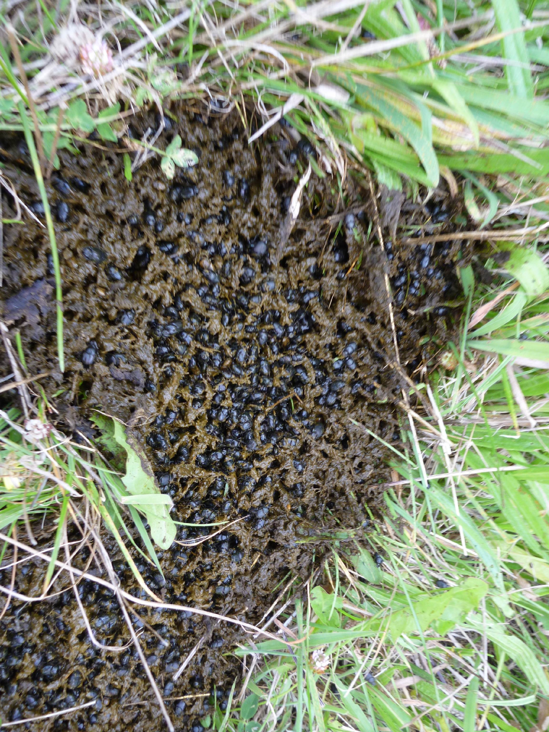
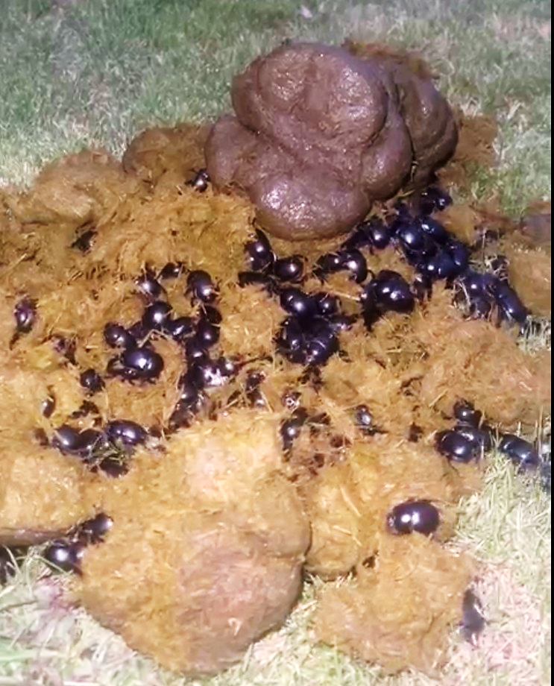
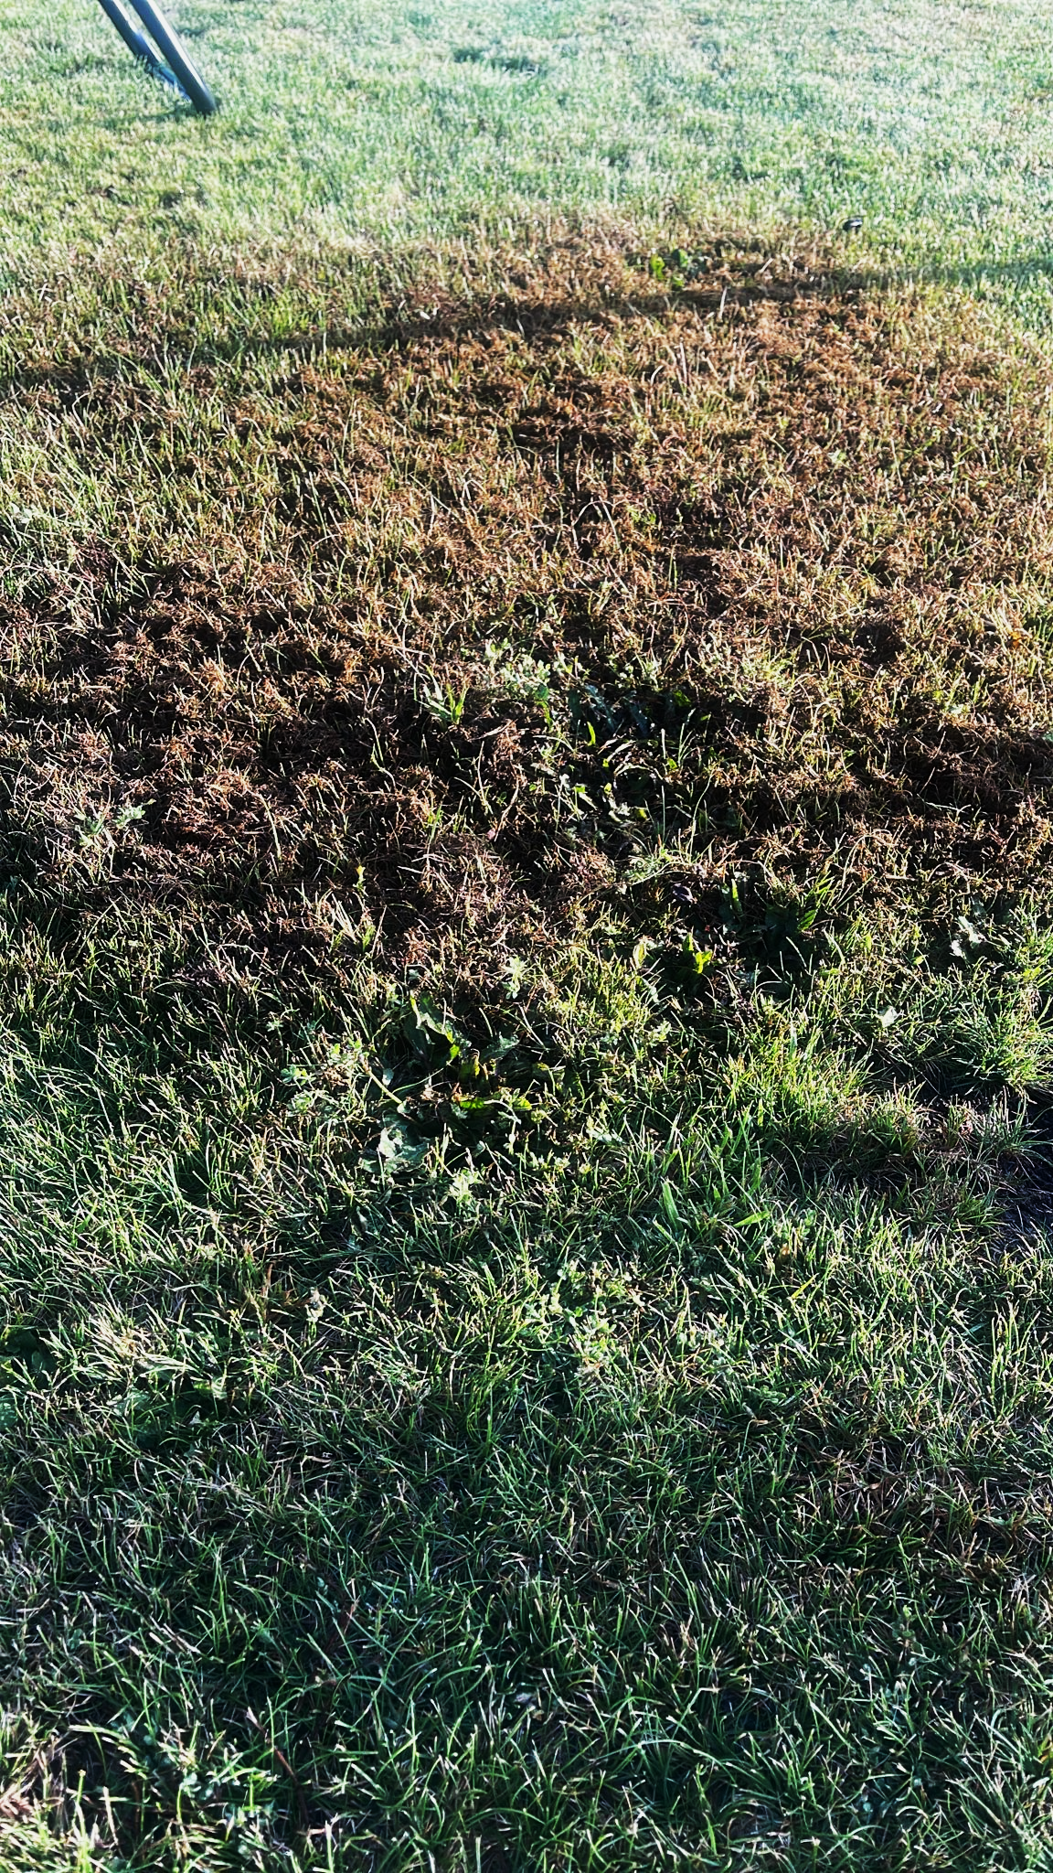
There is Good news: Dung Beetle Establishment is happening!
Released dung beetles on over 1,200 farms in New Zealand.
Customer and non customer feed back on establishment success has been great

Slide 26
Costs
Four-Seasons Package
$6,600 + GST ($1,650/colony).
Up to 4 species in 4 colonies. Best suited to farms with approx. 2000 SU.
Multiple Four-Seasons Package
$5,610/package + GST ($1,403/colony).
Up to 4 species in 8+ colonies. Best suited to farms with greater than 2000 SU.
15%
Catchment Pricing deals.
$4,950/package + GST ($1,238/colony). For 10 or more Four Seasons Packages!
$4,290/package + GST ($1,073/colony). For 25 or more Four Seasons Packages!
25%
35%
We only need a deposit!
Ordered within a few days

Slide 27
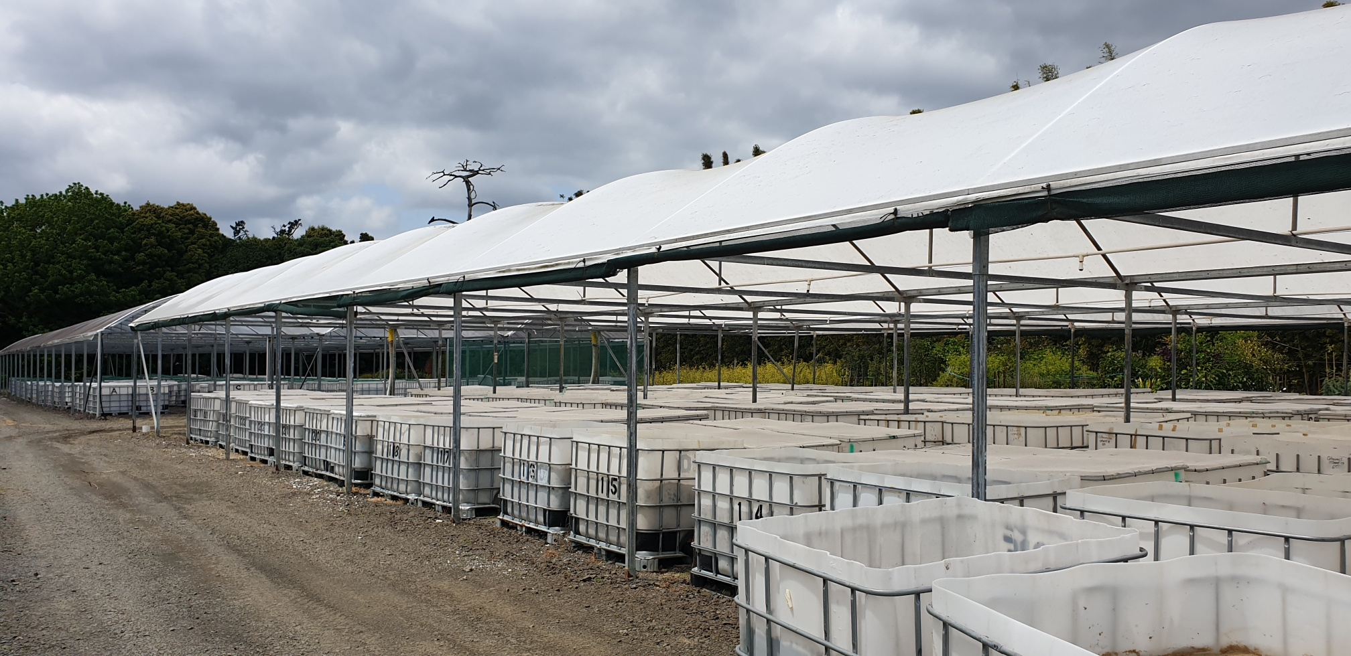
Dung Beetle Innovations
Mass rearing facility, 42 Totara Road, Whenuapai, Auckland

Slide 28
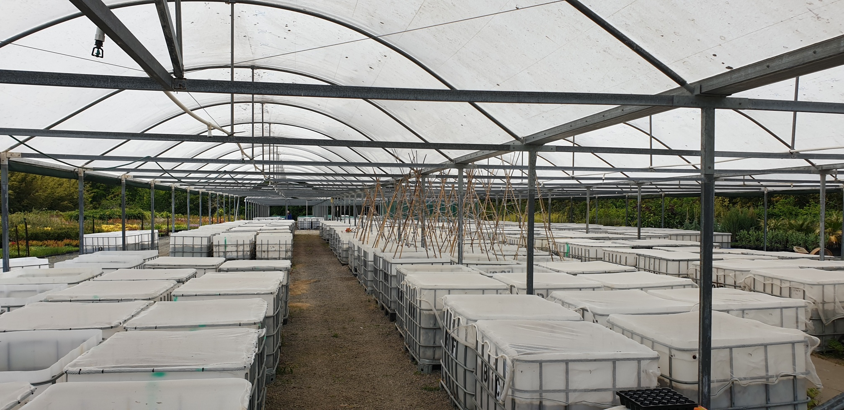
Dung Beetle Innovations
Mass rearing facility, 42 Totara Road, Whenuapai, Auckland

Slide 29
BUT……. Resistance is already rampant and present to most existing drench chemicals including mectins.
Thus, there really is only one solution to solve this, and solve it sustainably.

